Slide 1

SPAM MESSAGE FILTERING Mini Project (017016501)
 | Prepared by: Tirth Patel
 | Enrollment No: 21002170310038
Guided By : Mr. Krunal Panchal Assistant Professor (LJU) | B.E. [CSE] (5th Sem)

Slide 2
Content
ABSTRACT
INTRODUCTION
OBJECTIVE
Methodology
Future Work
Application
Advantages/Disadvantages
REFERENCES

Slide 3
Abstract
The proposed system employs a robust set of features extracted from email content, headers, and sender information, leveraging state-of-the-art ML algorithms for classification.
The feature extraction process involves the analysis of text content using natural language processing techniques, examining patterns in sender behavior, and evaluating the relevance of email headers.
These features are then used to train and optimize ML models, including but not limited to Support Vector Machines, Random Forests, and Neural Networks. The selection of the most suitable algorithm is based on comparative performance evaluations.

Slide 4
Introduction
A Spam Email Filtering System using Python is a robust solution designed to automatically identify and filter out spam emails from users' inboxes. Leveraging the power of machine learning and natural language processing, this system employs sophisticated algorithms to analyze the content, structure, and metadata of incoming emails.
The goal is to enhance user experience, protect personal information, and bolster cybersecurity measures by automating the identification and removal of spam emails.
Key components of this system include feature extraction techniques, classification algorithms, and real-time updates to adapt to evolving spam tactics

Slide 5
Objective
Real-time Analysis:
Objective: Implement real-time or near-real-time analysis of incoming emails to promptly identify and filter out spam.
Minimize False Positives:
Objective: Reduce the occurrence of false positives to avoid filtering out legitimate emails.

Slide 6
Methodology
Data Collection
Data Preprocessing
Feature Extraction
Model Selection
Training the Model
Monitoring and Maintainance

Slide 7
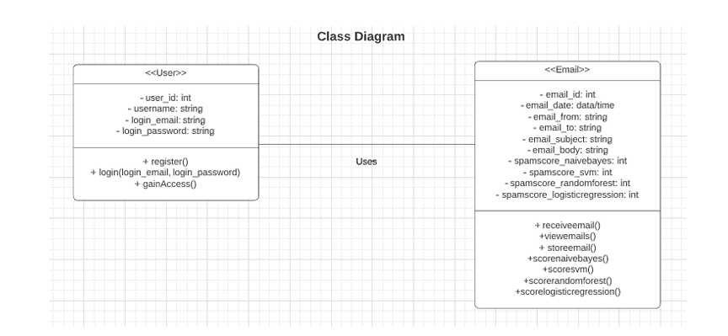
Class Diagram

Slide 8
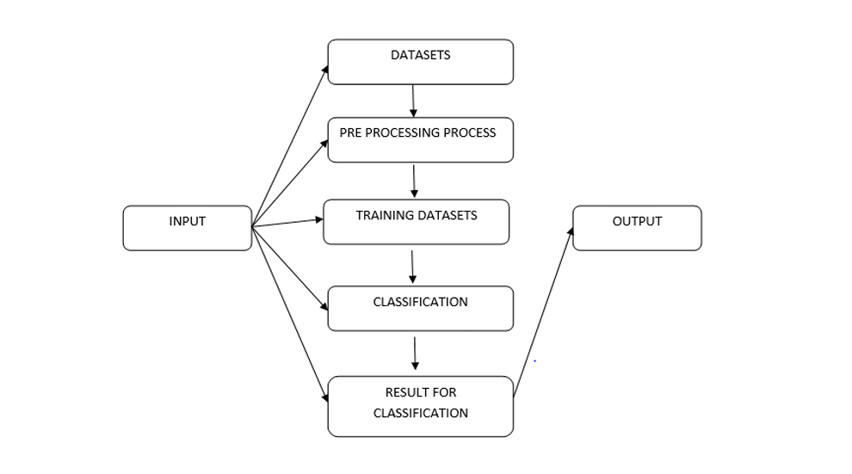
Use-Case Diagram

Slide 9
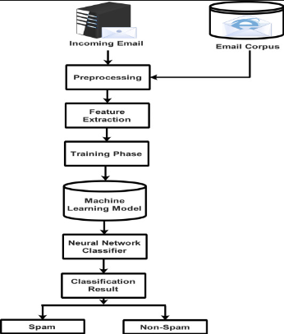
Activity Diagram

Slide 10
Future Scope
Explore advanced machine learning algorithms for improved accuracy.
Investigate additional features beyond bag-of-words.
Implement real-time spam filtering.
Analyze user email interaction patterns.
Explore scalable cloud-based solutions.
Optimize for mobile devices.
Collaborate with the open-source community for continuous improvement.
Multi-language Support
Integrate user feedback for continuous improvement.
Conduct analysis to identify and counter sophisticated spamming.

Slide 11
Application
Preventing the spread of spammy content in comments, private messages, and user-generated content
Filtering out spam posts, comments, and messages in online discussion forums and community platforms.
Filtering out spam messages sent through public Wi-Fi network portals and communication channels.
Preventing spammy messages in collaboration tools and project management platforms used for team communication.
Protecting users from spam messages received through mobile messaging applications.

Slide 12
Advantages/Disadvantages
Advantages
Enhanced Security
Improved User Experience
Resource Optimization
Improved Network Bandwidth
Protection Against Content Pollution
Disadvantages
False Positives:May incorrectly identify legitimate messages as spam
False Negatives: Some spam messages may still bypass filters
User Privacy Concerns
Ineffectiveness Against Image-Based Spam

Slide 13
References
Spam message filtering using python and machine learnig
Online source :- https://www.youtube.com/watch?v=YncZ0WwxyzU&t=5302s&ab_channel=CampusX
kaggle for online dataset
:- https://www.kaggle.com/datasets/uciml/sms-spam-collection-dataset
Feature extraction of text data using Tfidf Vectorizer
:- https://www.youtube.com/watch?v=Yo327cc818g&t=0s
Overview of Pickle File:
https://www.youtube.com/watch?v=6Q56r_fVqgw&ab_channel=Indently
How to run code on Streamlit:
https://www.youtube.com/watch?v=Pe4gUSIxte8&ab_channel=DatAInvestor

Slide 14
THANK YOU

